Slide 1
HOISTING

Slide 2
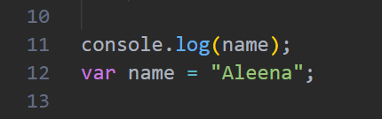
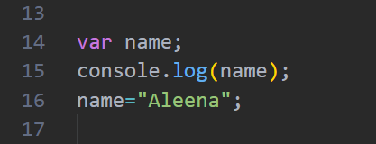
WHAT IS HOISTING?
Hoisting is a JavaScript behavior where variable and function declarations are moved to the top before the code runs. It does not mean JavaScript changes the code or rewrites it. Instead, JavaScript processes the declarations first before it starts executing the code line by line.
Let’s take a look at an example. As shown in the code, console.log(name) is executed before the variable name is assigned the value "Aleena"
As shown in the code this is how JavaScript treats the code after hoisting. The variable name is declared first, then it is accessed using console.log(), and finally the value "Aleena" is assigned to it.

Slide 3
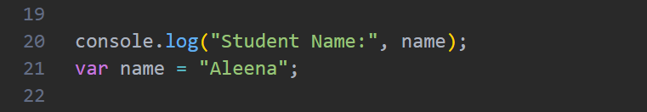
Hoisting with var
In the example below, we are applying the concept of hoisting on a var variable. The var keyword allows JavaScript to move the variable declaration to the top of its scope before executing the code. However, only the declaration is moved, not the assigned value.
Before executing the code, JavaScript performs hoisting. It moves the declaration var name; to the top and automatically assigns it the value undefined. The assignment part (name = "Aleena") remains at its original position. Therefore, when the console.log() runs, the variable exists but does not have a value yet, so it prints undefined.

Slide 4
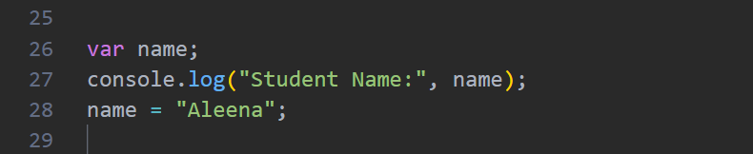

Slide 5
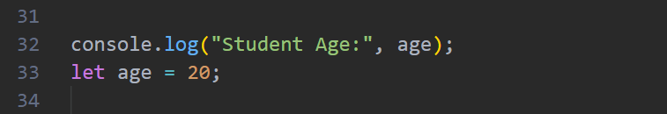
Hoisting with let
In this example, we are applying the concept of hoisting with the let keyword. Variables declared with let are also hoisted, but JavaScript does not initialize them with any value. Instead, they remain inside the Temporal Dead Zone (TDZ) until the declaration line is executed. Because of this, we cannot access a let variable before its declaration.
During hoisting, JavaScript creates the variable age, but it does not assign any value to it. The variable stays in the Temporal Dead Zone (TDZ). When console.log(age) tries to access the variable before the declaration, JavaScript stops execution and gives a ReferenceError.

Slide 6
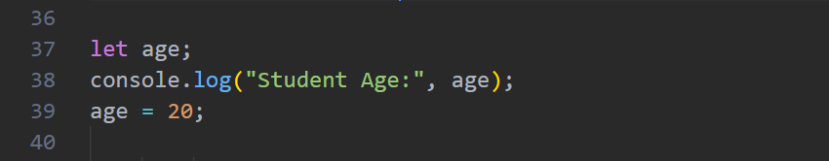

Slide 7
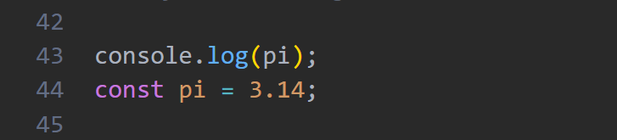
Hoisting with const
In this example, we are applying the concept of hoisting with the const keyword. Similar to let, variables declared with const are hoisted but are not initialized with a value. They also remain inside the Temporal Dead Zone (TDZ) until the declaration is reached. Therefore, accessing a const variable before its declaration will cause an error.
JavaScript moves the declaration of pi to the top, but the value 3.14 is not assigned immediately. Since pi is still inside the TDZ, the console.log() cannot access it and JavaScript throws a ReferenceError.

Slide 8
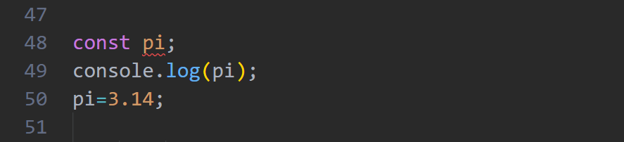
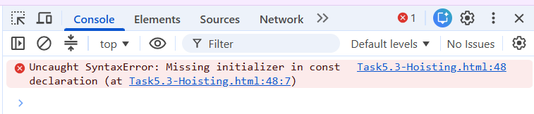

Slide 9
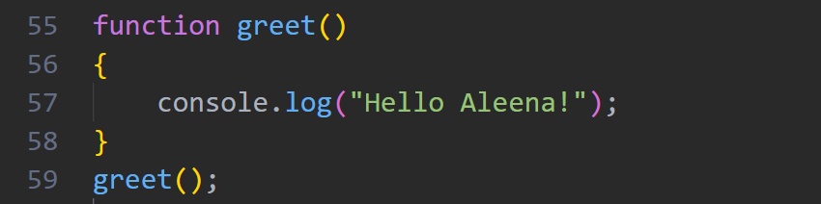
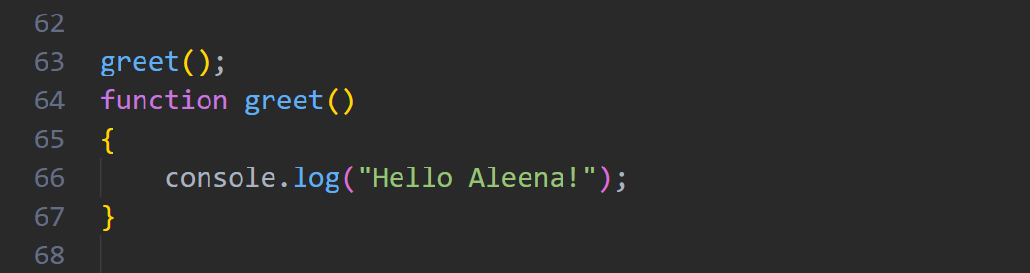
Hoisting with Function
In this example, we are applying the concept of hoisting with a function declaration. Unlike variables, JavaScript hoists the complete function, including its name and code block, to the top of its scope. We can call a function before writing its actual declaration in the program.

Slide 10
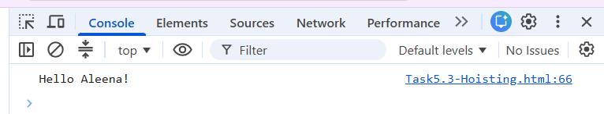
Before execution, JavaScript moves the complete function declaration to the top. Since the function is already available in memory, the first greet() call works successfully even though the function is written later in the code.

Slide 11
Why do we do hoisting?
Hoisting means JavaScript reads your variables and functions before it starts running your code. It first checks what things are created in the program and keeps information about them in memory. Because of this, JavaScript already knows that a variable or function exists when it reaches that line of code.
Benefits?
It helps JavaScript know which variables and functions are available before running the code.
Helps us to organize and work with our code.
Assists in interpreting the way the program is executed and read by JavaScript.

Slide 12
Thank You

